Slide 1



PnP Transformation – Solution Design Report
<Consultant Name>
<Title>
<Company Name>

Slide 2
Agenda
Assessment summary
Solutions that will be redesigned
Detailed approach per solution
Support for the app transformation
Roles and involved people
Responsibilities on both sides
Purpose of this presentation is to clearly explain what kind of customizations are needed for the customer based on business requirements and how they will be implemented.

Slide 3
Assessment summary

Slide 4
In-house solutions
C – Complexity
E – Effort to move
Legend
Solution | C | E
- Transform
- Abandon
- Unclear
- Easy to do
- Average
- Hard one

Slide 5
Third Party solutions
C – Complexity
E – Effort to move
Legend
- Transform
- Abandon
Solution | C | E
- Unclear
- Easy to do
- Average
- Hard one

Slide 6
App Maturity Level
Customer Preparedness
1
Branding
0
Remote provisioning
3
Composites and bus apps
0
Governance
0
Readiness from infrastructure and process perspective to move to app model?
Hosting environment decision done with needed testing towards the SP farm
Hosting environment available
Deployment process in place for SharePoint apps
Branding model impact to customizations?
Non-FTC deployment of branding
No custom master page (theme and JS injection)
Documented process and guidance for projects on how to deal with branding
Remote provisioning model existence and maturity level?
Site collections created using remove process
Assets (+content types) deployed during provisioning
Sub site creation managed via the provisioning solution
Maturity of the composite and business app structures?
Agreed patterns for cloud and on-premises app connectivity
Tested and verified models with reference implementation
Infrastructure and process existence for composite and business apps.
How do we control customizations in SharePoint?
Existence of generic guidance and architecture principals for app model.
ALM process documented and available
Standardized model to design and control customizations: consistency between solutions
Notes:
The numbers on the slide signify the “App Maturity Level” in the scale of (0-3)
0 – For solutions that cannot be moved into the App model

Slide 7
Solution transformation
What will be now actually done for the Office 365 to enable app model based solutions…

Slide 8
Solution Summary
Many of the solutions can be transformed to the new App model using proven techniques
Only limited set of solutions have been abandoned because they can be implemented using CSOM techniques
No known CAM blockers based on the analyses
All known requirements can be implemented using the known APIs in the Office 365
Solutions for app model | S
Branding
Notes:
The colours on the right indicate the simplicity with regards to the transformation process.

Slide 9
Branding
Branding
Complexity:
Medium
Owner:
High level requirements:
Typical Intranet features:
Custom page layouts
A branded site theme.
Social features (commenting, tag cloud)
Site Navigation
UI elements
Share price, world clock, weather, emergency information, image rotator
Other intranet features:
Site provisioning for collaborative sites
MySite customizations
Notes:
The team responsible for transforming the solution has been identified in the “Owner” section.
Example outline of high level requirement for a solution area

Slide 10
Branding
Branding
Complexity:
Medium
Owner: Contoso
Design and Notes
Branding on the master page will be achieved through the use of alternate CSS.
SP Color tool will be used to create the “spcolor” file which can then be referenced in the Theme.
Replace web parts with following approaches
Content by query and content by search OOB web parts
JS based reading and updating of data
Provider hosted apps with app parts
Avoid using custom master page for collaboration sites
Use CSS and JS to achieve the desired look and feel
Replace (delegate) controls with JS based implementations
Replace Content Query web parts with content search web parts.
Dashboards on the homepage will be designed using out of the box lists with JS Link.
Notes:
Example outline of design summary for a solution area
The team responsible for transforming the solution has been identified in the “Owner” section.

Slide 11
Logical architecture
Functionality A
Functionality B
Functionality C
Services
Branding
Framework
Provisioning
Timer Jobs
Branding
Development
Transformation
Notes:
Sample Logical Architecture

Slide 12
Framework
Framework = Agreed way to implement needed capabilities to align used models to product and service roadmap

Slide 13
Development focus areas
Provisioning framework
Remote timer framework
Branding and asset framework
Development framework
Transformation framework
Currently features are spread across multiple solutions.
Should just be one provisioning engine which takes care of the all required customizations.
Remove usage of feature framework elements and deploy assets using remote provisioning.
Timer jobs should be replaced by Azure Web jobs.
Updates to the existing functionalities to match app model techniques.
Branding topics.
Example: Use JavaScript for header and footer capability in the Branding solution to avoid need of custom master page
What goes to SP, what goes to CDN?
Chosen hosting platform impacts the detailed design of the capabilities for Office 365 apps directly. Framework needs to support both cloud and on-prem.
General design and guidance for the provider hosted app implementation missing. Typical topics are logging and caching techniques.
General design on removing FTC solutions.
Transformation tooling, like updating existing master pages or transforming custom list templates to new app model format.
Notes:
Example of development focus areas by functional area

Slide 14
Key considerations
Key decisions we agreed during the engagement

Slide 15
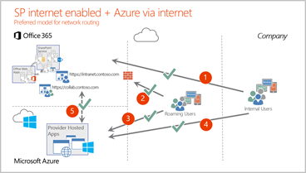
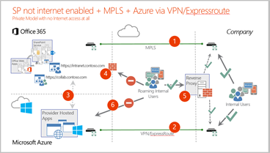
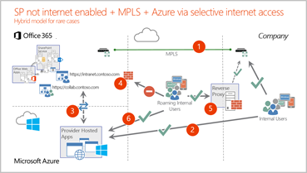
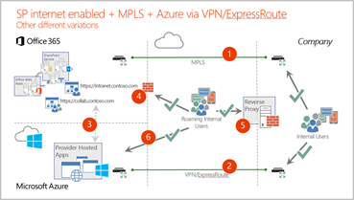
Network design and access
Overall network design will have significant impact on the different opportunities and implementation details
Notes:
Example Key consideration

Slide 16
PnP Transformation assistance

Slide 17
Application Modernization PnP Transformation Approach
Customer Preparedness
Solution Assessment
Architecture Session
STEP 1
Empower & Plan
App hosting configuration. Leverage available resources to ramp up dev resources
Analyze solution inventory / requirements and provide guidance on solution modernization
Provide architecture design guidance for selected scenarios
Deliverable:
Successful smoke test app to validate configuration
Deliverable:
Assessment report
Deliverable:
Architecture Design Report
Development SOW (optional)
Development & Testing
Deployment
STEP 2
Develop & Deploy
Provide funding to off-set costs associated with development and testing
Retract FTC
Deploy App solutions
Deliverable:
Tested solution artifacts
Deployment Guide
Deliverable:
Replace FTC by APP
Project signoff

Slide 18
Develop & Deploy
Development & Testing
Results in a Deployment Guide and solution artifacts.
Engagement Criteria | Roles & Responsibilities |  | Deliverable
 | Customer | Microsoft Partner
Requirement document Architecture Design document Completed readiness checklist Approved Statement of Work | Project management | Consultation by Partner SMEs Development by Partner resource + SME consultation | Tested solution artifacts Deployment Guide
Development
Developers
Module Overview
Kickoff
Development support
Technical input
Reference samples
Technical discussions
Testing support
Next Steps
Testing and documentation
Getting started
Stage
Everybody
Testers
Everybody
Audience

Slide 19
Develop & Deploy
Deployment
Support for deployment of modern SharePoint applications. Provide guidance for deployment of new modern applications and to retract FTC. Results in FTC applications replaced by App Model applications.
Engagement Criteria | Roles & Responsibilities |  | Deliverable
 | Customer | Microsoft Partner
Application solution design details Deployment Guide | Project Management Customer Developer Resource | Consultation by Partner SMEs Deployment by Partner resource + SME consultation Office 365 operational support Troubleshooting and support | Replace FTC by APP applications Project signoff
Everybody
PPE testing
Module Overview
Kickoff
Kickoff
Initial acceptance deployment
Initial acceptance deployment
Customer acceptance testing sign-off
Customer acceptance testing sign-off
Production deployment
Production deployment
Final verification
Kickoff
Initial acceptance deployment
Customer acceptance testing sign-off
Production deployment
Final verification
Final verification
FTC retraction
FTC retraction
Next Steps
Next Steps
Production Deployment
Post deployment activities
Stage
Audience

Slide 20
PnP Transformation support for Customer
Focus on every solution that needs to be converted
Identify the focus areas where <Customer> would require help from <Partner> resources.
Assigned SME to help with the needed actions and to work as a single point of contact for any additional information for the app transformation
Separate weekly meetings with third party providers
PnP transformation focuses on the customization migration
Content migration will be completed by <TBD> as part of the service transformation actions

Slide 21
Key Contacts
Area of Responsibility
Person – Title
Area of Responsibility
Person – Title

Slide 22
Other Office 365 related information

Slide 23

Questions?

Slide 24


© 2014 Microsoft Corporation. All rights reserved. Microsoft, Windows, and other product names are or may be registered trademarks and/or trademarks in the U.S. and/or other countries.
The information herein is for informational purposes only and represents the current view of Microsoft Corporation as of the date of this presentation. Because Microsoft must respond to changing market conditions, it should not be interpreted to be a commitment on the part of Microsoft, and Microsoft cannot guarantee the accuracy of any information provided after the date of this presentation. MICROSOFT MAKES NO WARRANTIES, EXPRESS, IMPLIED OR STATUTORY, AS TO THE INFORMATION IN THIS PRESENTATION.

